Slide 1


OFconnect
An OpenFlow SDN Library For Everyone
Deepa Karnad Dhurka
Ramya Bolla
15 Jan 2015
CodeChix Confidential Proprietary

Slide 2
Agenda
Introduction
OFconnect Design
Unit Test Automation
Controller Integration
SDN Setup
Get Started!
15 Jan 2015 CodeChix.org OFconnect

Slide 3
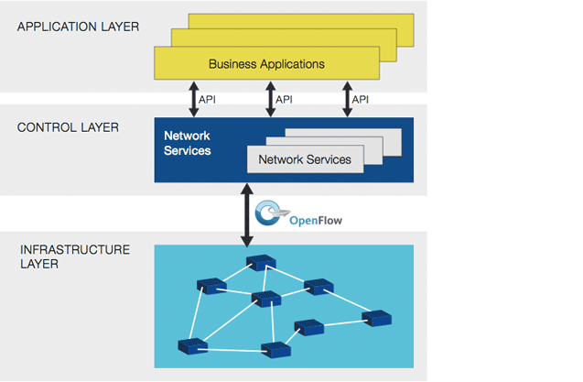
Software Defined Network
  The physical separation of the network control plane from the forwarding plane, and where a control plane controls several devices.
Source: opennetworking.org
15 Jan 2015 CodeChix.org OFconnect

Slide 4
OpenFlow Channel Library
Problem
Duplication
High coupling with Controller/Switch
Poor multi version support
CONTROLLER
OpenFlow Channel Library
Solution
Abstract out OF Channel
Support Controller & Switch
Package into a library
Open Source it!
OpenFlow Protocol Connection
SWITCH
15 Jan 2015 CodeChix.org OFconnect

Slide 5
Features
Functional
Hides wire protocol
Manages OF connections
Other
Multi-language bindings
Platform independence
15 Jan 2015 CodeChix.org OFconnect

Slide 6
Next Up
Introduction
OFconnect Design
Unit Test Automation
Controller Integration
SDN Setup
Get Started!
15 Jan 2015 CodeChix.org OFconnect

Slide 7
Design Goals
Performance under scale
        256K socket connections
Simultaneous multiple Transport Protocols
        TCP, UDP, TLS etc..
Easy addition of new Transport Protocols
Common API for controller & switch
15 Jan 2015 CodeChix.org OFconnect

Slide 8
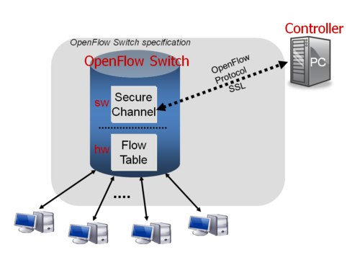
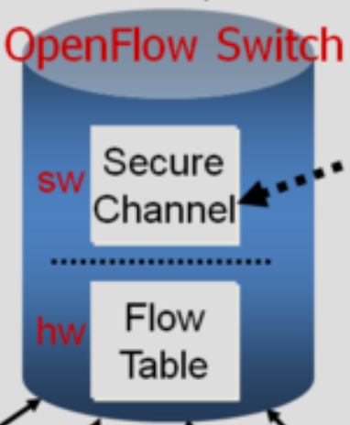
Scalability
Performance under scale
Controller is capable of handling 256K connections
TCP Datapath OFChannel (dpID:1, auxID:0)
UDP Auxiliary OFChannel (dpID:1, auxID:1)
UDP Auxiliary OFChannel (dpID:1, auxID:n)
TCP Datapath OFChannel (dpID:2, auxID:0)
UDP Auxiliary OFChannel (dpID:2, auxID:1)
UDP Auxiliary OFChannel (dpID:2, auxID:n)
TCP Datapath OFChannel (dpID:n, auxID:0)
UDP Auxiliary OFChannel (dpID:n, auxID:1)
UDP Auxiliary OFChannel (dpID:n, auxID:n)
15 Jan 2015 CodeChix.org OFconnect

Slide 9
Block Diagram
Controller/Switch
Swig Bindings
Java, Python etc.
OFconnect API
Elastic Pool
Net Services
TCP, UDP etc.
Poll Thread Util
Thread Mgr
15 Jan 2015 CodeChix.org OFconnect

Slide 10
OFconnect API
Controller/Switch
Swig Bindings
Java, Python etc.
OFconnect API
Elastic Pool
Net Services
TCP, UDP etc.
Poll Thread Util
Thread Mgr
15 Jan 2015 CodeChix.org OFconnect

Slide 11
cc_of_lib.h
Initialize
OF Channel Setup
Tx/Rx
cc_of_ret cc_of_lib_init
cc_of_ret
cc_of_lib_free
cc_of_ret cc_of_dev_register
cc_of_ret cc_of_dev_free
cc_of_ret cc_of_create_channel
cc_of_ret cc_of_destroy_channel
typedef int (*cc_of_accept_channel)
typedef int (*cc_of_delete_channel)
cc_of_ret cc_of_send_pkt
typedef int (*cc_of_recv_pkt)
15 Jan 2015 CodeChix.org OFconnect

Slide 12
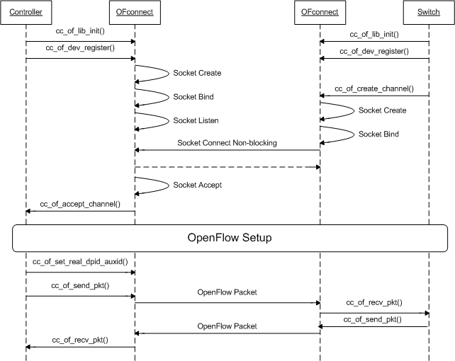
OF Channel Setup
15 Jan 2015 CodeChix.org OFconnect

Slide 13
OF Channel Setup Logs
ubuntu:~/deepa-git/mul-OFconnect/mul$ sudo ./mul
cc_onf_driver_lib-INFO: cc_of_lib_init(57): CC_OF_LIB Started Initializing
(process:7827): cc_onf_driver_lib-DEBUG: cc_of_lib_init(120): CREATED POLLTHR FOR listen sockets
(process:7827): cc_onf_driver_lib-DEBUG: cc_of_lib_init(131): CREATED POLLTHR FOR rwsockets
cc_onf_driver_lib-INFO: cc_of_lib_init(133): CC_OF_LIB initilaized successfully
cc_onf_driver_lib-INFO: cc_of_dev_register(232): Started Registering new Device
(process:7827): cc_onf_driver_lib-DEBUG: cc_of_dev_register(290): actual key returned 0x7f000001 ip address
(process:7827): cc_onf_driver_lib-DEBUG: fd: 10 fd_type: 0 pollin_func: 0x7f875cfb07ab pollout_func: (nil) events: 1
(process:7827): cc_onf_driver_lib-DEBUG: cc_of_dev_register(308): Created TCP listenfd
cc_onf_driver_lib-INFO: cc_of_dev_register(332):CC_OF_DEV initilaized successfullywith controllerIp:1.0.0.127, siwtchIp:0.0.0.0, controllerL4Port:6633
2015/01/04 16:56:48 MUL-CONTROLLER: (c_alloc_thread_ctx) nthreads:0
2015/01/04 16:56:48 MUL-CONTROLLER: c_thread_event_loop: tid(1523967744)
2015/01/04 16:56:48 MUL-CONTROLLER: c_thread_event_loop: tid(1515575040)
2015/01/04 16:56:48 MUL-CONTROLLER: c_main_thread_final_init: running tid(1532360448)
2015/01/04 16:56:48 MUL-CONTROLLER: (mul_cc_thread_event_loop_lib_support) tid(1532360448)
2015/01/04 16:56:48 MUL-CONTROLLER: mul-vty app registered
2015/01/04 16:56:48 MUL-CONTROLLER: VTY THREAD RUNNING
2015/01/04 16:56:53 unknown: Vty connection from 127.0.0.1
==== start mininet ====
2015/01/04 16:57:38 MUL-CONTROLLER: (mul_cc_of_accept) Accept received dpid:31 auxid:0x1f
2015/01/04 16:57:38 MUL-CONTROLLER: (mul_cc_of_accept) New switch context created
2015/01/04 16:57:38 MUL-CONTROLLER: (mul_cc_of_accept) switch:port str:127.0.0.1:49879
2015/01/04 16:57:38 MUL-CONTROLLER: (of_switch_add) Added to the hashtable dpid:31
2015/01/04 16:57:38 MUL-CONTROLLER: (of_send_hello) Send Hello to library dummy_dpid:31
2015/01/04 16:57:38 MUL-CONTROLLER: (c_thread_tx) Sending packet to library 31
15 Jan 2015 CodeChix.org OFconnect

Slide 14
Net Services
Controller/Switch
Swig Bindings
Java, Python etc.
OFconnect API
Elastic Pool
Net Services
TCP, UDP etc.
Poll Thread Util
Thread Mgr
15 Jan 2015 CodeChix.org OFconnect

Slide 15
Net Services Callbacks
Callbacks
TCP Registration
typedef struct net_svcs_ {
int (*open_clientfd) (..);
int (*open_serverfd) (..);
int (*accept_conn) (..);
int (*close_conn) (..);
ssize_t (*read_data) (..);
ssize_t (*write_data) (..);
} net_svcs_t;
net_svcs_t tcp_sockfns = {
tcp_open_clientfd,
tcp_open_listenfd,
tcp_accept,
tcp_close,
tcp_read,
tcp_write,
};
15 Jan 2015 CodeChix.org OFconnect

Slide 16
HOWTO Add L4 Proto
Enumerate the new protocol: L4_type_e
Define NET_SVCS callback functions
Define socket POLL-IN/POLL-OUT callbacks
15 Jan 2015 CodeChix.org OFconnect

Slide 17
TCP Net Services Logs
ubuntu:~/deepa-git/mul-OFconnect/mul$ sudo ./mul
2015/01/04 16:56:53 unknown: Vty connection from 127.0.0.1
==== start mininet: channel setup ====
(process:7827): cc_onf_driver_lib-DEBUG: poll_fd_process(401)[oflisten_thr]: POLLIN on fd 12
(process:7827): cc_onf_driver_lib-DEBUG: process_listenfd_pollin_func(92):, Calling netsvcs Accept, dev_key->ControllerIP 2130706433, dev_key->SwitchIp 0
(process:7827): cc_onf_driver_lib-DEBUG: poll_fd_process(401)[rwthr_1]: POLLIN on fd 8
(process:7827): cc_onf_driver_lib-DEBUG: pollthr_pri_pipe_process_func(507)[rwthr_1]: message received: fd type: 1, fd 31, fd action 0, poll events 5, in func: 0x7f875cfb1f9f, out func: 0x7f875cfb2b71
(process:7827): cc_onf_driver_lib-DEBUG: tcp_accept(474): client_ip:16777343 port:49879
2015/01/04 16:57:38 MUL-CONTROLLER: (mul_cc_of_accept) Accept received dpid:31 auxid:0x1f
(process:7827): cc_onf_driver_lib-DEBUG: tcp_accept(502): Updated TCP channel State to CC_OF_RW_UP
=== rx/tx ====
(process:7827): cc_onf_driver_lib-DEBUG: poll_fd_process(401)[rwthr_1]: POLLIN on fd 31
(process:7827): cc_onf_driver_lib-DEBUG: tcp_read(516): Receiving from socket 31
(process:7827): cc_onf_driver_lib-DEBUG: process_tcpfd_pollin_func(225)[rwthr_1]: Read a pkt on tcp sockfd: 31, dp_id: 31, aux_id: 31and sent it to controller/switch
2015/01/04 16:57:38 MUL-CONTROLLER: (of_send_hello) Send Hello to library dummy_dpid:31
2015/01/04 16:57:38 MUL-CONTROLLER: (c_thread_tx) Sending packet to library 31
(process:7827): cc_onf_driver_lib-DEBUG: poll_fd_process(412)[rwthr_1]: POLLOUT on fd 31
(process:7827): cc_onf_driver_lib-DEBUG: process_tcpfd_pollout_func(260)[rwthr_1]: Sent a pkt out on tcp sockfd: 31
15 Jan 2015 CodeChix.org OFconnect

Slide 18
Block Diagram
Controller/Switch
Swig Bindings
Java, Python etc.
OFconnect API
Elastic Pool
Net Services
TCP, UDP etc.
Poll Thread Util
Thread Mgr
15 Jan 2015 CodeChix.org OFconnect

Slide 19
Thread Management
Poll-thread Util
Thread mgr
Thread Admin Block
15 Jan 2015 CodeChix.org OFconnect

Slide 20
Inside A Thread
Poll Loop
Net Services Protocol Callbacks
POLL IN/OUT
Add/Del FD's
Control Pipe
POLL IN/OUT
Net Services Pollin/Pollout Callbacks
POLL IN/OUT
Pkt Send
Data Pipe
OFconnect
API Tx
OFconnect
API Rx
15 Jan 2015 CodeChix.org OFconnect

Slide 21
Elastic Pool
Elastic Pool
Poll Thread Util
Poll Thread Util
Thread Mgr
Thread Mgr
Block 1
Block 2
Block n
15 Jan 2015 CodeChix.org OFconnect

Slide 22
Elastic Pool
Global ofrw_pollthr_list
  Sorted: decreasing no. of available sockets
cc_find_or_create_rw_pollthr_safe()
  Iterates to the last thread with availability
15 Jan 2015 CodeChix.org OFconnect

Slide 23
Elastic Pool
cc_add_sockfd_rw_pollthr_safe()
  Calls cc_find_or_create_rw_pollthr_safe()
  Adds socket fd to rw pollthread
cc_del_sockfd_rw_pollthr_lockfree()
      Deletes socket from thread
      Sorts the list
15 Jan 2015 CodeChix.org OFconnect

Slide 24
Thread Manager Logs
Poll-in
(process:7827): cc_onf_driver_lib-DEBUG: adp_thr_mgr_poll_thread_func(866)[rwthr_1]: listing 4 items of updated pollfd_arr
(process:7827): cc_onf_driver_lib-DEBUG: adp_thr_mgr_poll_thread_func(875)[rwthr_1]: thr_pvt_p->pollfd_arr[0].fd: 8
(process:7827): cc_onf_driver_lib-DEBUG: adp_thr_mgr_poll_thread_func(875)[rwthr_1]: thr_pvt_p->pollfd_arr[1].fd: 10
(process:7827): cc_onf_driver_lib-DEBUG: adp_thr_mgr_poll_thread_func(875)[rwthr_1]: thr_pvt_p->pollfd_arr[2].fd: 31 (process:7827): cc_onf_driver_lib-DEBUG: adp_thr_mgr_poll_thread_func(875)[rwthr_1]: thr_pvt_p->pollfd_arr[3].fd: 32 (process:7827): cc_onf_driver_lib-DEBUG: adp_thr_mgr_poll_thread_func(813)[rwthr_1] before poll
(process:7827): cc_onf_driver_lib-DEBUG: poll_fd_process(401)[rwthr_1]: POLLIN on fd 32
(process:7827): cc_onf_driver_lib-DEBUG: tcp_read(518): Received 176 bytes from socket 32
(process:7827): cc_onf_driver_lib-DEBUG: process_tcpfd_pollin_func(144): RECEIVED PKT LENGTH IS 176 on channel dp_id-32 aux_id-32
(process:7827): cc_onf_driver_lib-DEBUG: process_tcpfd_pollin_func(157)[rwthr_1]: Received a message \u0001\u0006
2015/01/04 16:57:39 MUL-CONTROLLER: (mul_cc_recv_pkt) Recv received dpid:32 auxid:32 msg_len:176
Poll-out
(process:7827): cc_onf_driver_lib-DEBUG: poll_fd_process(401)[rwthr_1]: POLLIN on fd 10
(process:7827): cc_onf_driver_lib-DEBUG: pollthr_data_pipe_process_func(673)[rwthr_1]: message received: size: 32, fd : 31
(process:7827): cc_onf_driver_lib-DEBUG: poll_fd_process(412)[rwthr_1]: POLLOUT on fd 32
(process:7827): cc_onf_driver_lib-DEBUG: process_tcpfd_pollout_func(260)[rwthr_1]: Sent a pkt out on tcp sockfd: 32
(process:7827): cc_onf_driver_lib-DEBUG: poll_fd_process(460)[rwthr_1]: Resetting POLLOUT flag for fd 32
15 Jan 2015 CodeChix.org OFconnect

Slide 25
Next Up
Introduction
OFconnect Design
Unit Test Automation
Controller Integration
SDN Setup
Get Started!
15 Jan 2015 CodeChix.org OFconnect

Slide 26
gtester
Two ways to run tests
  make runtest OR
  gtester --verbose -o=<log.xml> -k <test.exe>
Coverage
      cc_pollthr_mgr.c – 100%
      cc_of_util.c – approx. 75%
      cc_tcp_conn.c – approx. 80%
15 Jan 2015 CodeChix.org OFconnect
Notes:
pollthr_test.c
pollthread_tc_1 Basic health of single pollthread upon bringup and tear down
Test Primary Pipe and Data Pipe
Test Self-Destruct of pollthread
Test add and delete of FDs
pollthread_tc_2 Addition/Deletion of new pipe(s)
Test pipe creation and addition to the pollthread
Test pollin function on the new pipe
Test deletion of pipe(s)
pollthread_tc_3 Exercise receive path of data - POLLIN on socket
Test socket addition to the poll loop with unix sockets
Test pollin function to test receive of packet
Delete the socket from pollthread
pollthread_tc_4 Exercise send path of data - POLLOUT on socket
Test socket addition to the poll loop with unix sockets
Test pollout function to test transmit of packet
Delete the socket from pollthread
pollthread_tc_5 Exercise listen/accept of TCP sockets in pollthread
Test creation of a listen pollthread
Test accept of socket via listen pollthread
Test message on the read-write socket

Slide 27
UT Results
TEST: /home/libccof/deepa-git/OFconnect/tests/pollthr_test.exe... (pid=12123)
/pollthread/tc_1: OK
/pollthread/tc_2: OK
/pollthread/tc_3: OK
/pollthread/tc_4: OK
/pollthread/tc_5: OK
PASS: /home/libccof/deepa-git/OFconnect/tests/pollthr_test.exe
TEST: /home/libccof/deepa-git/OFconnect/tests/util_test.exe... (pid=12154)
/util/tc_1: OK
/util/tc_2: OK
PASS: /home/libccof/deepa-git/OFconnect/tests/util_test.exe
15 Jan 2015 CodeChix.org OFconnect
Notes:
util_test.c
util_tc_1 Verify one rw pollthread and one listen pollthread via utility functions
Test creation of rw pollthread via utility function
Test creation of listen pollthread via ap_thr_mgr API
Test global rw_pollthread_list entry
util_tc_2 Exercise TCP NET_SVCS to create a tcp socket and receive message
Note: this test requires port 6633 to be available
Test API cc_of_dev_register with a receive function that prints the received text message
Simulate the client (switch) with its own rw pollthread and NET_SVCS TCP pollin/pollout functions
Test 'connect' to the server from the switch
Test addition of rw socket (of client's) to its rw pollthread: cc_add_sockfd_rw_pollthr_safe utility function
Test process_tcpfd_pollout_func for simulated switch by writing to client socket fd directly into the data pipe of the rw pollthread
Test receive of the message at server (controller)

Slide 28
Next Up
Introduction
OFconnect Design
Unit Test Automation
Controller Integration
SDN Setup
Get Started!
15 Jan 2015 CodeChix.org OFconnect

Slide 29
HOWTO Integrate OFconnect
Implement three API callbacks:
(*cc_of_accept_channel)()
(*cc_of_delete_channel)()
(*cc_of_recv_pkt)()
Controller/Switch process start/restart:
        cc_of_lib_init()
        cc_of_dev_register()
Controller/Switch cleanup:
        cc_of_dev_free()
        cc_of_lib_free()
15 Jan 2015 CodeChix.org OFconnect

Slide 30
Next Up
Introduction
OFconnect Design
Unit Test Automation
Controller Integration
SDN Setup
Get Started!
15 Jan 2015 CodeChix.org OFconnect

Slide 31

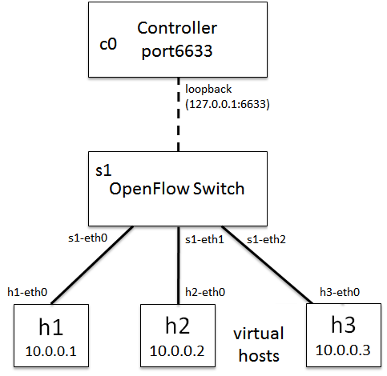



Test Setup
c0 MUL Controller
Port:6633
OFconnect Driver
Virtual Hosts
sudo mn --controller=remote, ip=127.0.0.1 --switch ovsk
15 Jan 2015 CodeChix.org OFconnect

Slide 32
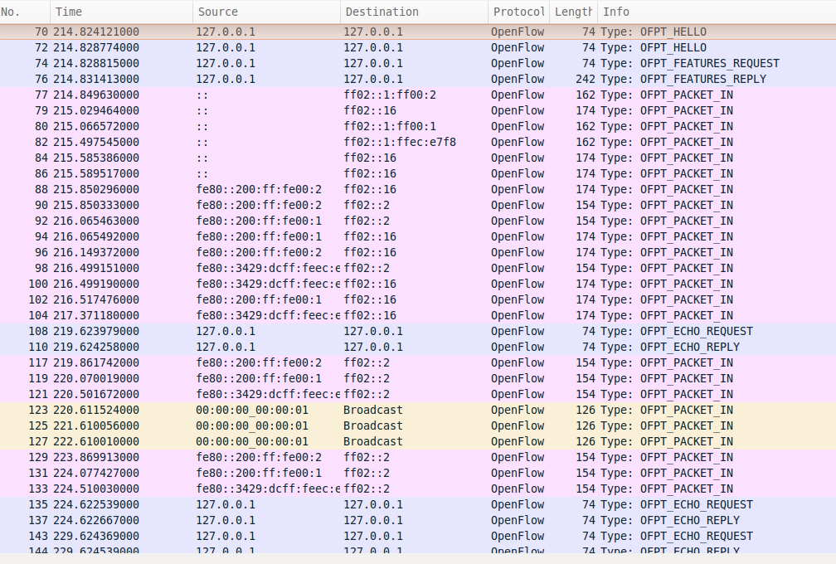
Wireshark Capture
18 Nov 2014 CodeChix.org OFConnect

Slide 33
Looking Ahead
Enhance
TLS, IPv6
Greater OF Awareness
Scale
256K connections
Perform
Profile and Benchmark
15 Jan 2015 CodeChix.org OFconnect

Slide 34
OFconnect Summary
Simple and powerful
True OpenFlow
Easy to integrate
GPL v2
15 Jan 2015 CodeChix.org OFconnect

Slide 35
Next Up
Introduction
OFconnect Design
Unit Test Automation
Controller Integration
SDN Setup
Get Started!
15 Jan 2015 CodeChix.org OFconnect

Slide 36
Join and Contribute!
Getting Started
      https://github.com/CodeChix-OpenSource/OFconnect/wiki
Prototype Controller
      https://github.com/codechix/mul-OFconnect
Email: organizers@codechix.org
15 Jan 2015 CodeChix.org OFconnect

Slide 37
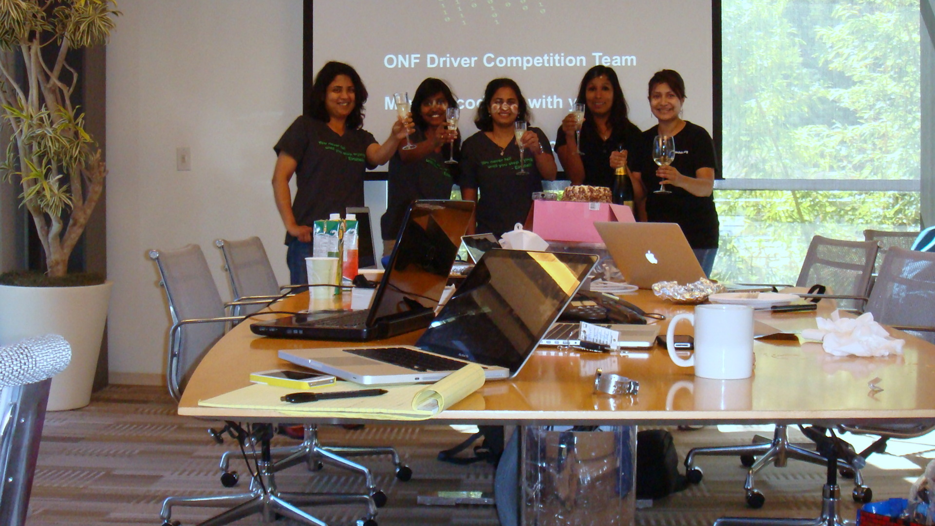
Thank you!
CodeChix Confidential Proprietary

